Slide 1


Accenture
Data Analytics and Modeling.

Slide 2


Today's agenda
Project recap
Problem
The Analytics team
Process
Insights
Summary

Slide 3

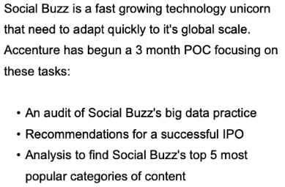
Project Recap

Slide 4


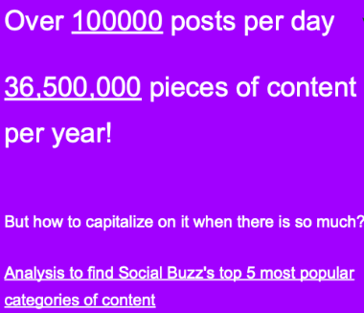
Problem

Slide 5



The Analytics team

Slide 6
Data Understanding
Process
1
Data CLeaning
2
3
Data Modeling
4
Data Analysis
5
Insight Visualization

Slide 7
The Needed an over all rearranging and also model using merging three datasets in one to make it more meaningfull, and also to make it more valuable .
and also sort out th top 5 to look up and also DataVisualization one will easily understand the dataset .

Slide 8
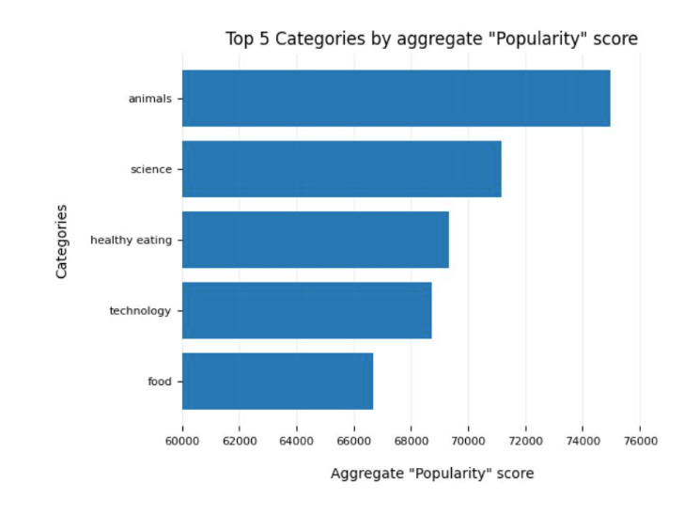

Slide 9
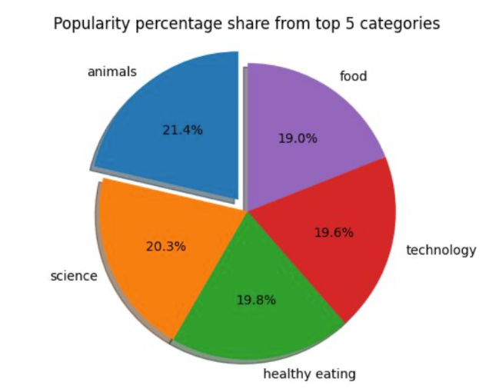

Slide 10

Thank you!
ANY QUESTIONS?

